Slide 1
Strategies and Actors in Financial Markets Microstructure and flow trading for Intermediaries
Amine Raboun, Ph.D
Quantitative Researcher & Developer - Abu Dhabi Investment Authority
Lecturer, Paris Dauphine – PSL University

Slide 2
Outline
The role of intermediaries: The position of the middleman
Between different investors
In between investors and infrastructure
Organization inside a brokerage firm
The price formation process
Liquidity and Market Efficiency
The emergence of new market structure
Focus on execution
Essentials of Microstrucutre
Algorithmic trading
Pre and Post trade analysis, TCA, consultancy
Direct Market Access
Conclusion

Slide 3
The role of Intermediaries
The position of middleman

Slide 4
Middleman Role: Issuers <-> Investors
Corporate Brokerage
Investment Banks have senior bankers, working on Corporates' debt)
When a company issue shares (or bonds), she needs a book runner to be in between her and the investors. Usually, the Broker guarantees a price per share (conditioned by the number of shares sold the first day).
It is the same to raise capital on markets (conditions are on volatility around the issuance and market volumes, guaranteed prices are pegged on market VWAPs),
it is the same for share buy back programs.
Some brokers are mandated by one company to make the market on their stocks.
Corporate Access
Brokers organize meetings (one-to-one or conferences) between issuers (mostly CFOs) and investors
Companies have the opportunity to explain their strategy
Investors have the opportunity to challenge the accuracy of explanations.
Analysis (research) -- Brokers issue reports on
macroeconomics (strategists)
companies and sectors (fundamental analysts)
systematic (factorial) portfolios (quantitative analysts).

Slide 5
Middleman Role: Investors <-> Investors
Block trading (OTC) - ``upstairs trading''
Broker's Sales traders (qualitatively) know the portfolio of investors (anonymity)
Especially because the Broker's Sales sold them Analysts' ideas
Some small brokerage firms are specialized in sectorial small cap liquidity seeking.
Can have discretion to find blocks for one week.
Market Easing – Facilitation
Take quantity at a negotiated price
by voice for large quantities
by electronic means for small quantities (answers at “the touch”).
a broker provides liquidity on other asset classes too, if needed.
Members of exchange – “common trading”
Historically brokers were the founders (and only members) of exchanges
Now they are clients of exchanges, and no more the first clients (market makers and HFT are more important).
In some exchanges, brokers can be privileged provided they pay for.
Brokers guarantee best execution, provide Direct Market Access and electronic services (algo trading, TCA and consultancy).

Slide 6
Middleman Role: Investors <-> Infrastructure
Regulation and market surveillance
Brokers are part of the surveillance infrastructure (risk limits)
They have to warn national authorities when they detect suspicious behavior
They work with exchanges and authorities when asked to
Clearing, Collateralization and Settlement
Brokers dispatch drop-copies of trades to keep track of investor’s positions where needed
Brokers are connected to CCPs and custodians, thus play the role of middlemen between end investor and infrastructures
Repo and financing
Prime brokers are providing repo, reverse repo and financing

Slide 7
Who pays whom ?
Issuers pay for corporate brokerage
but they come to brokers' conferences for free,
in exchange they increase their chances to be included into investors' portfolios.
Investors pay fees for trading
They have to trade anyway; thus, they consider they have to pay the fees
Before MIFID II, investors used to choose to pay high touch or low touch fees.
With high touch they have access to financial analysis (research) on top of electronic trading
MIFID II oblige brokers to unbundle execution and research, and to pay hard dollars for reports and meeting.
Investors vote at Extel Refinitiv and MorningStar surveys.
Most Buy-sides are using the Extel ranking as a repartition key to split their flows amongst brokers.
MorningStar survey is more quantitative than Extel, but less used.
This is a reinforcing ecosystem: the more clients you have the best ranked, thus it is very difficult for newcomers. This is good for concentration.
Investment banks pay to have a better market access and a better access to information.
the Brokerage business is overcrowded, nevertheless some Investment banks pay to maintain their brokerage arm alive.

Slide 8
Organization inside a brokerage firm
In a typical organization:
Sales: select and distribute the reports, they are in charge of the global sales relationship
Analysts: write the reports, talk to the CFO of the corporates and to investors 'Portfolio managers.
Sales-traders: take investors orders (by phone) via Dealing Desks and seek liquidity> They select and send flow-oriented reports ( often written by quant analysts ).They are in charge of upstairs trading , and route the remaining orders to traders or trading algorithms
Traders: mix manual and algorithmic traded orders
Dealers: manage broker’s prop books
AES sales-traders: receive and monitor algo orders sent directly by low touch clients. They are the only one to see the low touch flows. They offer execution consultancy to clients.
DMA teams: are monitorigin DMA orders and operate and help desk.
Middle and back offices: maintain the relationship with investors middle and back offices and with CCPS

Slide 9
The Price Formation Process
Liquidity and Market efficiency

Slide 10
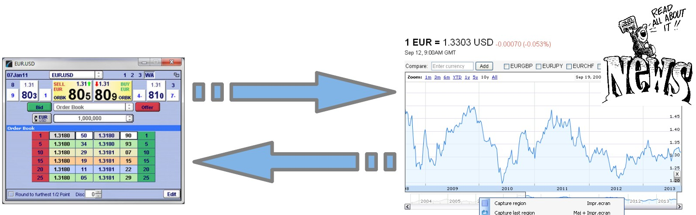
Liquidity contributes to price dynamics
The dynamic of the Price Fromation (or Price Discovery) Process is twofold:
Forward dynamics Backward dynamics
The balance between offer and demand at t move The comparison between current prices and future prices at t+1 expectations triggers new offers and demands
It simultaneously creates (endogenous) information and conveys (exogenous) information.

Slide 11
A liquid market is a mixed market
A trading facility has two main goals:
Achieve an equilibrium price that matches the offer and demand. The more buyers, the higher the price and the more sellers the lower the price. This is the source of market pressure
Disseminate prices that digested most of the available information concerning the valuation of assets
The synchronization of sellers and buyers is the main component of illiquidity (and thus market impact):
When an external news is disclosed: the synchronization is immediate;
When information affect differently investment time horizons: the impact is smoother;
A market with different investment philosophies and different time horizons is more liquid.
Theoretical developments in [LGR1O] (macroscopic scale) and [LLLL13] (microscopic scale) .

Slide 12
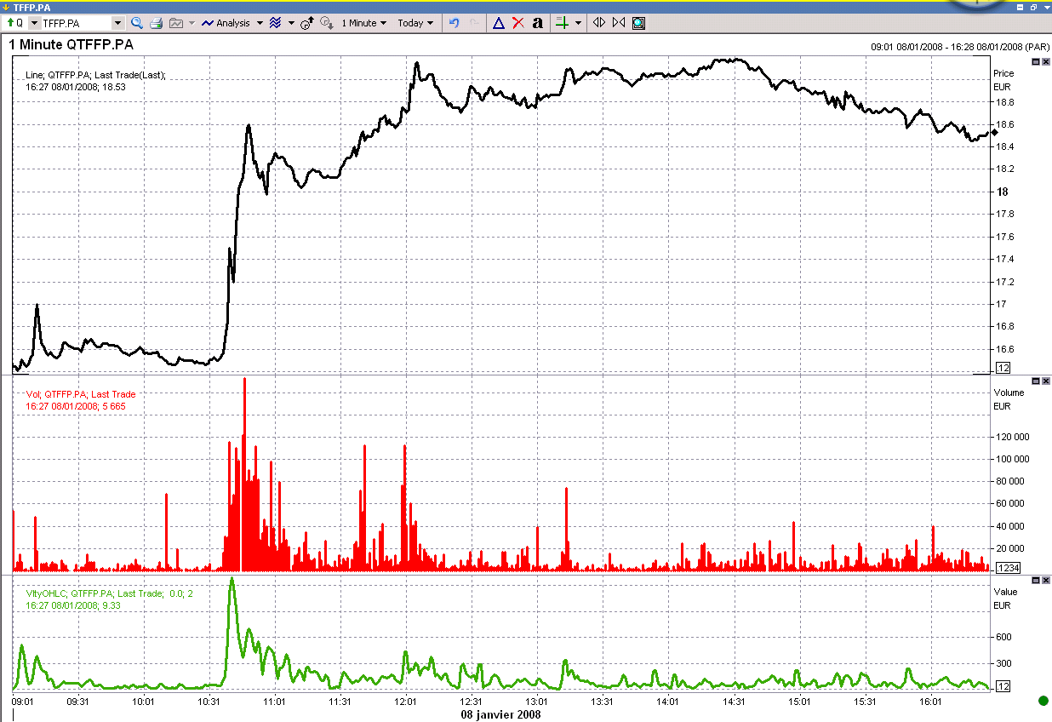
Example
TF1 price around the announcement of the end of advertising on public channels (8 Jan 2OO8).

Slide 13
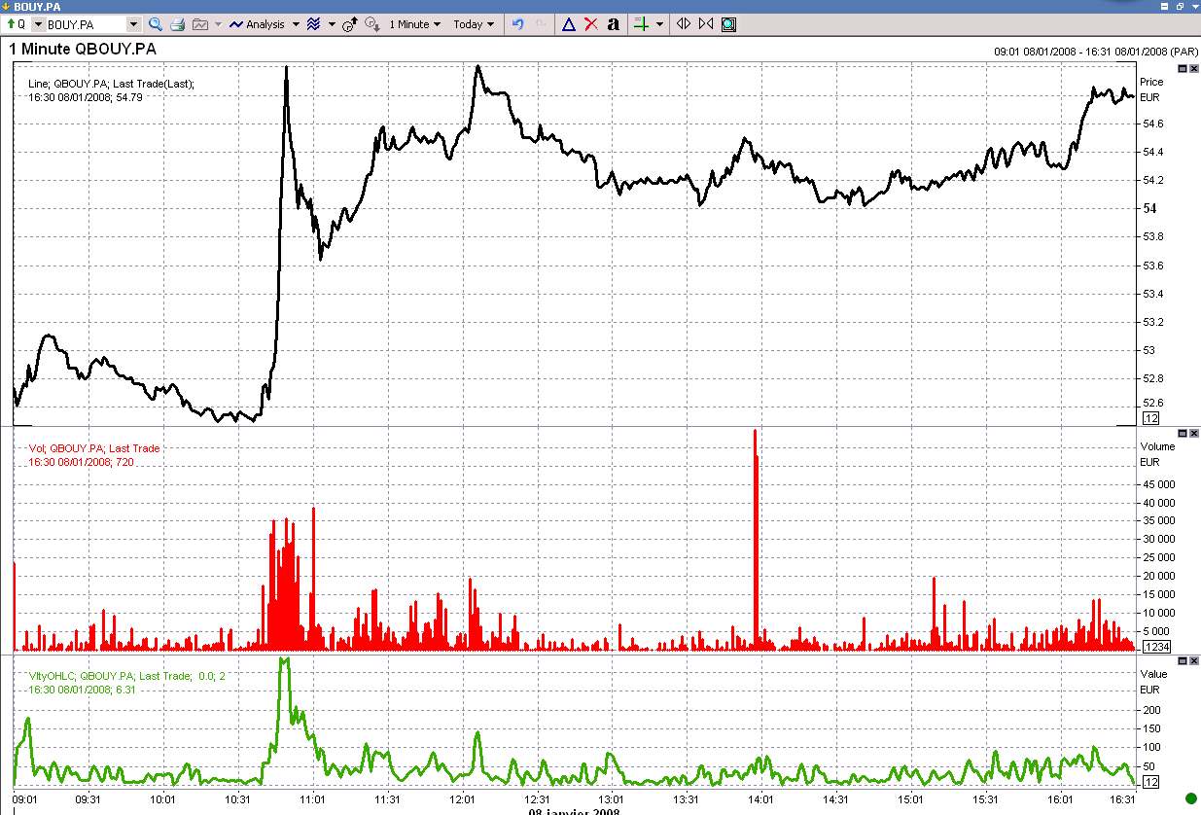
Example
Bouygues price around the announcement of the end of advertising on public channels (8 Jan. 2OO8).

Slide 14
Cost of Liquidity
What is liquidity ?
How long you are have to wait until you trade the security at the fair price
How much price rebate, you have to give in order to be able to trade simultaneously
From the viewpoint of an investor , cost to buy or sell a security is made of
Fixed explicit costs (fees, memberships, technology, best exec proof investments, etc);
Variable (implicit) costs, made of
Bid-Ask spread (and other liquidity measures [AMP1O]),
Cost of an option [Lon95],
Market Impact related to the capacity of his strategies [ATHLO5],
Information leakage related to adverse selection [GS8O].
Hence from the viewpoint of an issuer, having liquid shares lowers his cost of capital.

Slide 15
Market makers peculiar role
Market makers are said to increase liquidity [HS83] because they:
Increase the number of trades successfully executed in the market
While bearing the inventory risk/costs
Reduce the bid-ask spread (i.e. linear transaction costs);
Digest information while exposed to adverse selection
Adverse selection comes from information asymmetry between other investors and market makers. To protect themselves, market markers implemented as much bilateral trading as possible.

Slide 16
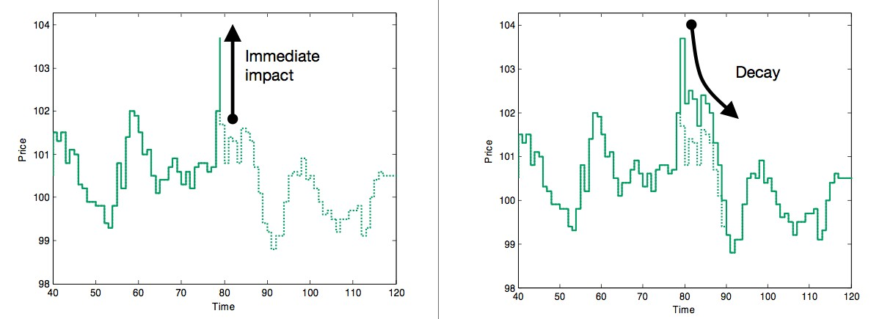
Market makers and market impact
market impact is the difference between the effective price dynamics (given some trades) and what it “would have been” without these trades;
market makers should be able to “arbitrage” such moves, at the benefit of the price efficiency.

Slide 17
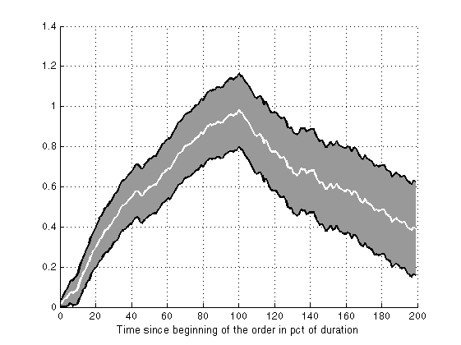
Market impact of large trades is a reality
Real market impact of large orders from [LLB+13]
Price move (in bid-ask spread, the end of the meta order is at T = 1OO)
market impact has two phases: an immediate one (due to the volume pressure), and a decay

Slide 18
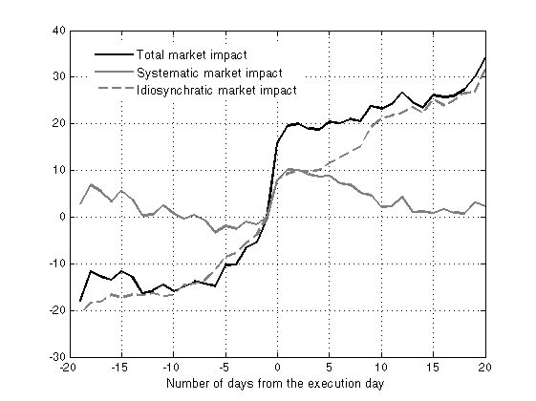
The meaning of permanent market impact
Price move (in bid-ask spread, the end of the meta order is at T = 1OO)
market impact has two phases: an immediate one (due to the volume pressure), and a decay
Is Permanent Market Impact just realization of price discovery (backward)?
Is Market Impact information leakage (backward) or mechanical pressure on the orderbook dynamics (forward)?

Slide 19
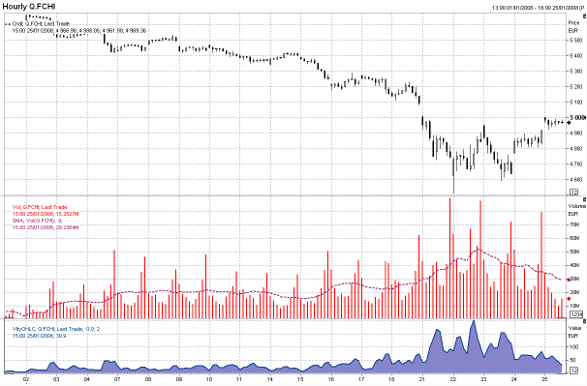
Extreme market impact events
Kerviel Market Impact - Studied in “Large bets and market Crashes” [KO13].

Slide 20
Trading in a Fragmented Market

Slide 21
In practice: the case of equity markets
MiFID in Europe and Reg NMS in the US opened the door to more competition between exchanges. Targeting:
increase the quality of service , more (enough?) reliable and faster matching engines
better, more meaningful and easier to access information , web sites of Chi-X BATS and fidessa
decrease prices , lower trading fees, maker/taker fees
incentive to innovation . Pegged orders, hidden orders, new matching rules
No significant change in listing.
No competition on fixing (close) auctions.

Slide 22
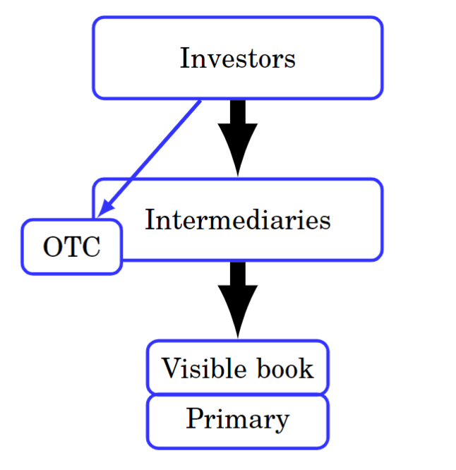
The emergence of a new market structure
Trading before market fragmentation

Slide 23
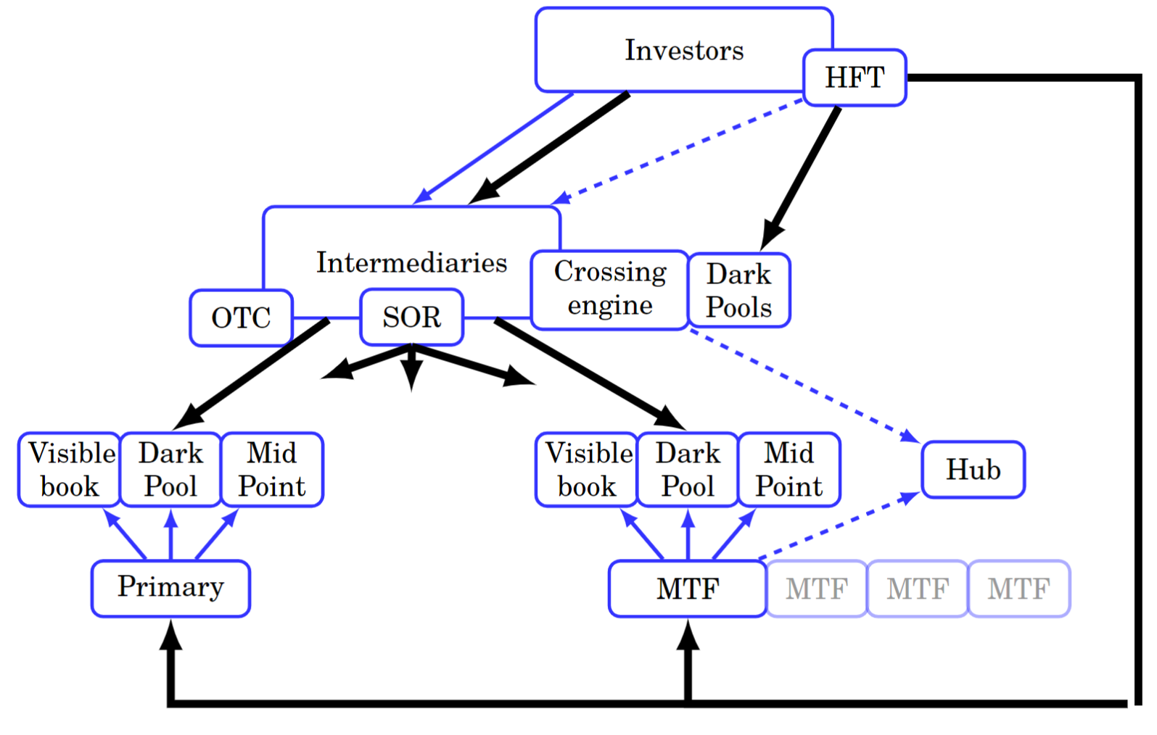
The emergence of a new market structure
The trading now takes place on a distributed network of heterogenous trading platforms.

Slide 24
New participants
MTFs offered trading in a one size fits all approach,
they needed liquidity providers, thus offered rebate to limit orders,
statistical arbitrage technology (overnight risk) made automated market makers to produce High Frequency Traders.
As HFT provided competitive quotes, Brokers had to implement Smart Order Router (under regulatory pressure, since MiFID decided to implement a two-layered competition),
This sudden increase of complexity (and a lack of education) frightened some participants (suspecting that the profit of HFT were their lost),
Trading platforms offered anonymity features, claiming it will reduce information leakage (birth of European Dark Pools),
Exchanges provided internalization features, and brokers provided crossing capabilities,
High fixed costs and high competition leaded to mergers (LSE + Turquoise, BATS + Chi-X, ICE + Nyse, Euronext + ?, etc);
Exchanges are close to be technology vendors.

Slide 25

A standard optimization paradox
The more parameters you add to a situation, the better the optimum.
But the more complex to find.

Slide 26
A standard optimization paradox
The more parameters you add to a situation, the better the optimum.
But the more complex to find.
simultaneously, a large academic literature emerged to optimize the trading process (see [Leh13] in the Handbook on systemic risk, 2O13 for a review):
as a result, a large trader can now liquidate a position using a majority of limit (liquidity adding) orders. Optimal schemes to seek liquidity on a large set of pools are known [PLL11] (even the market making problem is solved [GLFT13]).
The notion of liquidity changed. A dynamical and probabilistic approach is now needed.

Slide 27
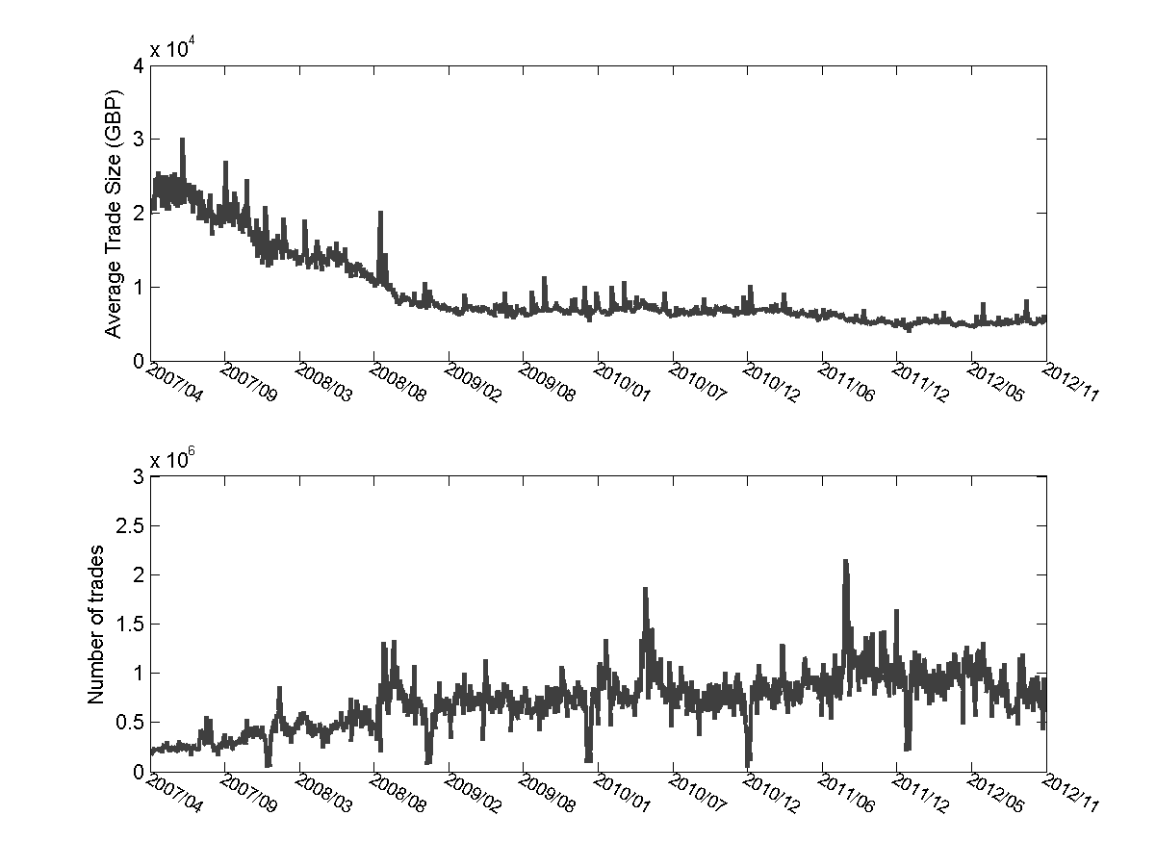
Orders or meta-orders?
A transaction occurs when two orders match, usually one is fully executed and the order only partially executed.
the partially executed order has more information leakage (and potentially more impact) than the fully executed one;
the smaller the orders, the better.
Electronic trading is a way to shu½e liquidity at a small scale.
Evolution of the Average Trade Size and the number of trade per day on the LSE.

Slide 28
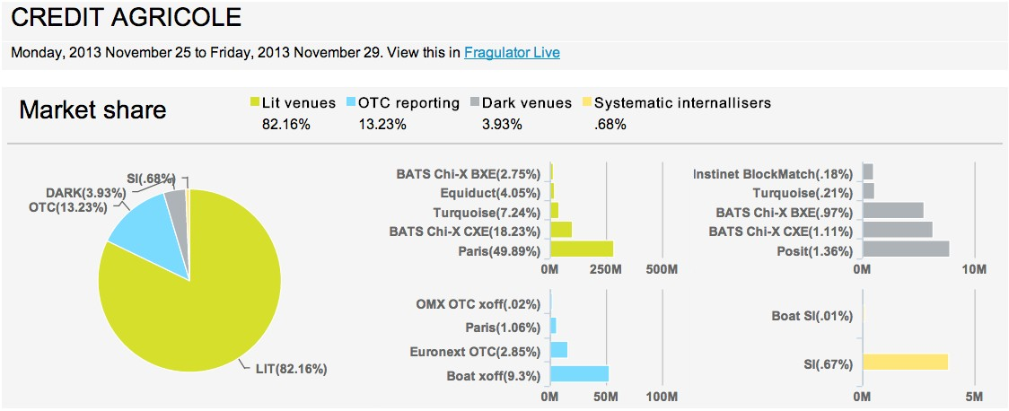
A typical fragmented stock
These numbers add all the transactions: they are good to estimate exchanges revenues.

Slide 29
A Different Way to Fragment in the US vs. in Europe
Regulations (Reg NMS and MiFID) implemented competition across trading venues: Exchange / Regulated Markets; ECN / MTF (Multilateral Trading Facilities).
In the US
The “trade through rule” demand to trading venues to re-route orders that can obtain a better price “somewhere”;
That for, a “National Bid and Offer” (NBBO) is available to venues;
3 SIP (centralized Securities Information Processor) aggregate quotes coming from all venues to build a Consolidated Tape. They are maintained by the The Consolidated Tape Association (CTA).
They are then sent back to venues so that the NBBO is known by everyone.
Thanks to this mechanism an order can be send “blindly” to any venue and take profit of competition (on the paper...).

Slide 30
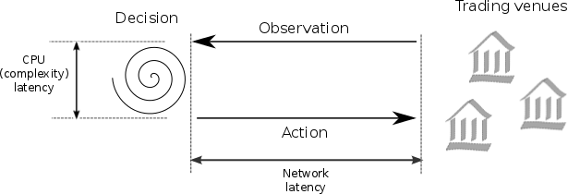
Consolidated Tapes
In Europe, no similar mechanism have been implemented
because when you compare two best bids (or asks) in the US, if one is larger than the other, you can be sure you will have more selling on this venue at the end of the day, even if you count the post trading costs (clearing and settlement costs mainly: there is only one silo).
In Europe post trading costs can be different from one venue to the other (because of post trade costs),
hence a consolidated tape will not tell a trader a price is more attractive on one venue or on the other.
The Regulator demanded to broker to implement Smart Order Routers on their side.
A SOR is parametrized to implement a “Best Execution Policy” (choice of the venues, priority / ranking rules, etc).

Slide 31
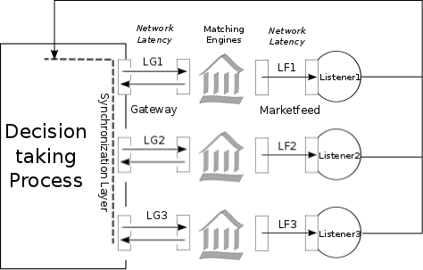
It is a little more complex...
The latency complexifies the story:
If a SOR is at 1 ms from venue A, 2 ms from venue B and 3 ms from venue C,
when he look at the three orderbooks, they are not synchronized,
since the SOR has an SLE connection, it can have some insight about the accuracy of its snapshots.
If the SOR see 2O shares at the offer at 1O.OO on A, 3O at the same price on B and 5O on C, and if the SOR want to buy 1OO shares, it can split it in 2O(A)+3O(B)+5O(C) and send the three orders (i.e. 3 insert IOC Buy orders at 1O.OO) at t_{O}
but the 3 orders will reach the venues at t_{O} + 1, t_{O} + 2 and t_{O} + 3 ms (respectively).
If 2O of the 5O shares at C are duplicates of the 2O at A owned by a trader hosted at A and with a latency of 1 ms to C, he can cancel his shares before the SOR order reaches C. In such a case the SOR will obtain 7O=2O(A)+2O(B)+3O(C) instead of the 1OO it expected

Slide 32
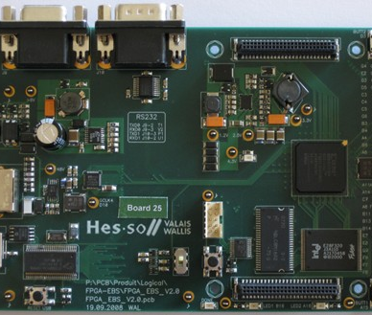
Dealing with latency
One solution is to delay the order to A by 2 ms and to B by 1 ms, so that the three orders reach the venues simultaneously. But the delays are not that deterministic, and waiting more means having a largest probability of an exogenous orderbook change.
Hardware can be useful.
GPU is not that good since it is slow to transfer data from a motherboard to the GPU, and in trading we talk about being able to deal with a fast flow of data.
The flow to work on is made of the SLC.
FPGA is better since it can embed physical IP layers, hence you can put on an FPGA: (1) the reading of the flow, (2) its enrichment with indicators. Without paying that more latency.

Slide 33
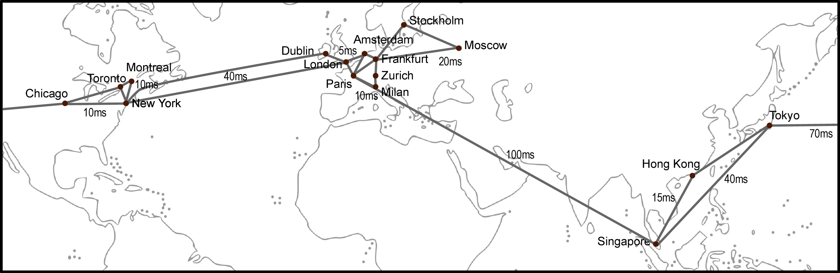
High Frequency or Low Latency?
Low latency means to be able to react first to external information. It is not mandatory for this external information to be frequent. To implement such strategies you must be fast on long distances.
High frequency means to be able to (re)adjust your orders 1OO times per second. To implement this you need to be very close to the orderbooks you are working in.
You cannot be simultaneously close to 2 venues that are not located in the same datacenter.

Slide 34
Timestamping and Event Ordering
Remark on Timestamping and Event Ordering:
Two events occurring simultaneously at points A and B in space are perceived in a different orders with respect to the position of the observer.
When an observer suffers from a delay, he can choose between (1) taking decisions on estimators of the state of the orderbook, or (2) implementing a simultaneous optimization on its strategy.
As an example, to trade in Dark Pools :
[GNKV1O] estimates the liquidity in each pool and implements a deterministic optimization;
[ABD1O] uses a minimum regret approach;
[PLL11] implements a stochastic implementation of an optimal trading scheme.
The first approach is good for on opportunistic trading (hedge fund), the second for a rare and not really flexible flow (investor), the last one is good for very large systematic flow (broker).

Slide 35
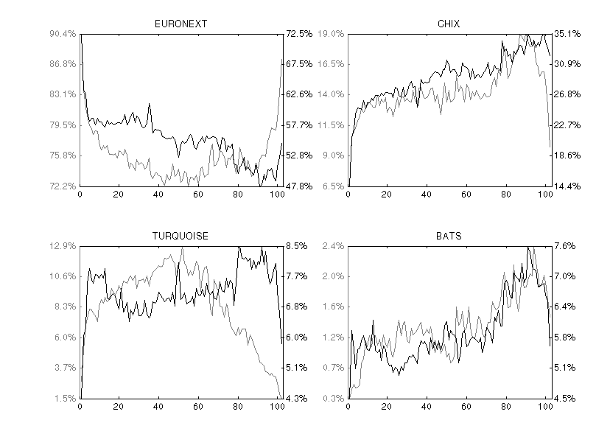
Measuring fragmentation (examples)
The probability that a trade typically occurred on a given venue should take into account the time,
the probability to find liquidity on a venue? (given a trade occurred)
The Average Trade Size on each venue (is in fact the average size of a limit order..).
Cost of a “roundtrip” for a given amount of Euros on each venue.
Market Share of venues on a typical Fench Stock in 2O12

Slide 36
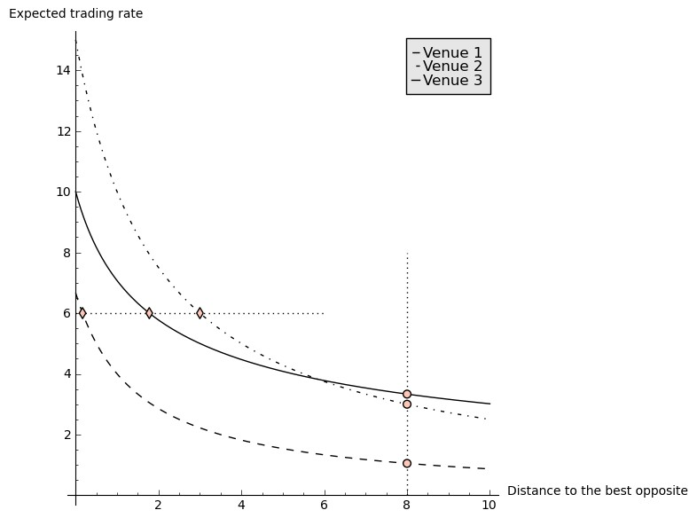
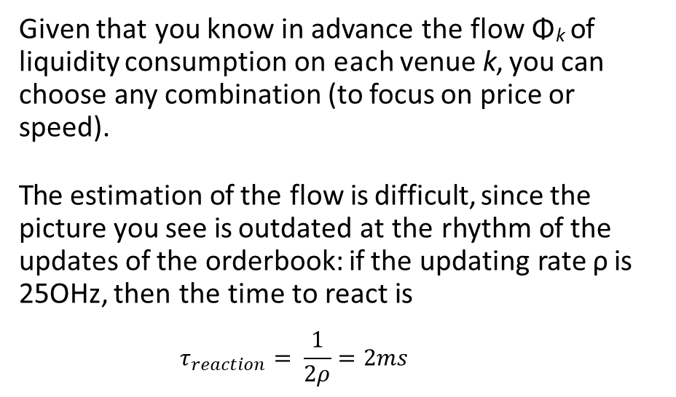
Viewpoint of an optimal (trader) router
Given that you know in advance the flow Φ_{k} of liquidity consumption on each venue k, you can choose any combination (to focus on price or speed).
The estimation of the flow is difficult, since the picture you see is outdated at the rhythm of the updates of the orderbook: if the updating rate ρ is 25OHz, then the time to react is
$$τ_{reaction}= \frac{1}{2ρ}=2ms$$
In [PLL11] and [LLP13], we show how to adjust the limit price and the quantities to send to each venue for an arbitrary criterion (in a stochastic world). And we provide uncertainty bounds on the result.

Slide 37
Execution and
Algorithmic Trading

Slide 38
Algorithmic trading
In most brokerage firms, Algorithmic trading executes more than 8O% of the orders (in value). It is thus used internally (to execute care or corporate orders) and by (low touch) clients.
Algo users pay fees (2 to 8 bps) and have no guarantee on the execution price.
Buy sides would like to have Algos the most similar as possible from one provider to another, since integration in the trading tools is a never-ending challenge. But Sell sides try to differentiate, leading to Algos with fancy names and “new” features.
Algo types
Long duration Algos are controlled via a Benchmark, giving an indication on the criterion to minimize (reflecting user’s belief in good proxies for liquidity and risk), and having different parameters.
Short duration Algos (or Robots) are synthesizing smart features of orders (icebergs, on the close, stop orders, snipers, etc) or seek liquidity on more than one platform (SOR, liquidity seekers). Their parameters make the balance between speed and price.
Algos can be customized: benchmarked algos can send robots, and the type of an algo can change on market conditions, like: “start with a VWAP and switch to PoV if the market volume is more than 2 times the ADV”.
Program trading Algos are dedicated to portfolio trading, with synchronization features (in cash or market exposure).

Slide 39
Trading algorithms: Typical uses
Benchmark | Region of pref- erence | Order characteristics | Market context | Type of hedged risk
PoV | Asia | Large order size (more than 1O% of ADV: Average daily consoli- dated volume) | Possible negative news | Do not miss the rapid propa- gation of an unexpected news event (especially if I have the in- formation)
VWAP / TWAP | Asia and Europe | Medium size (from 5 to 15% of ADV) | Any “unusual” volume is negligi- ble | Do not miss the slow propaga- tion of information in the market
Implementation Shortfall (IS) | Europe and US | Small size (O to 6% of ADV) | Possible price opportunities | Do not miss an unexpected price move in the stock
Liquidity Seeker | US (Europe) | Any size | The stock is expected to “oscil- late” around its “fair value” | Do not miss a liquidity burst or a relative price move on the stock

Slide 40
Trading algorithms: Typical features
Benchmark | Type of stock | Type of trade | Main feature
PoV | Medium to large market depth | (1) Long duration position | (1) Follows current market flow, (2) Very reactive, can be very aggressive, (3) More price opportunity driven if the range between the max percent and min percent is large
VWAP / TWAP | Any market depth | (1) Hedging order, (2) Long duration position, (3) Unwind tracking error (delta hedging of a fast evolving inventory) | (1) Follows the “usual” market flow, (2) Good if market moves with unexpected volumes in the same direction as the order (up for a buy order), (3) Can be passive
Implementation Shortfall (IS) | Medium liquidity depth | (1)Alpha extraction, (2) Hedge of a non-linear position (typically Gamma hedging), (3) Inventory- driven trade | (1) Will finish very fast if the price is good and enough liquidity is available, (2) Will “cut losses” if the price goes too far away
Liquidity Seeker | Poor fragmented market depth | (1) Alpha extraction, (2) Opportunistic position mounting, (3) Already split / scheduled order | (1) Relative price oriented (from one liquidity pool to another, or from one security to another), (2) Capture liquidity everywhere, (3) Stealth (mini- mum information leakage using fragmentation)

Slide 41
Pre and Post trade analysis, TCA consultancy
With electronic trading, a full range of services is offered:
Buy sides are performing TCA (Transaction Cost Analysis) to compare their brokers on a monthly basis
Pre trade analysis provides automated assistance to Algo parameters tuning (taking market impact / market risk into account), it computes betas, exposures, etc of a list of algos sent by Dealing Desks.
Post trade analysis: at the end of the day, the generation of a report is automated to allow to understand fast what happened during the day for each Dealing desk. Performances are compared with unexpected and expected new arrivals, and with usual performances and performances of other clients.
Monitoring: is conducted during the life of algos, analytics are grouping trading lines according to market conditions to dynamically explain the potential causes of performance degradation, so that sales-traders can adjust some parameters or call the Buy side Dealing Desk
Execution Consultancy is available on demand too. Expersts discuss with clients to help them to tune parameters for their own use, or to design customize new Alogs. Bbacktest can be done, models or parameters can be sent to clients by FIX/FTP
While it is easy to un-plug an Algo provider, brokers try to develop stickiness of clients “vous ne viendrez plus chez nous au hazard”

Slide 42
Conclusion Questions ?

Slide 43
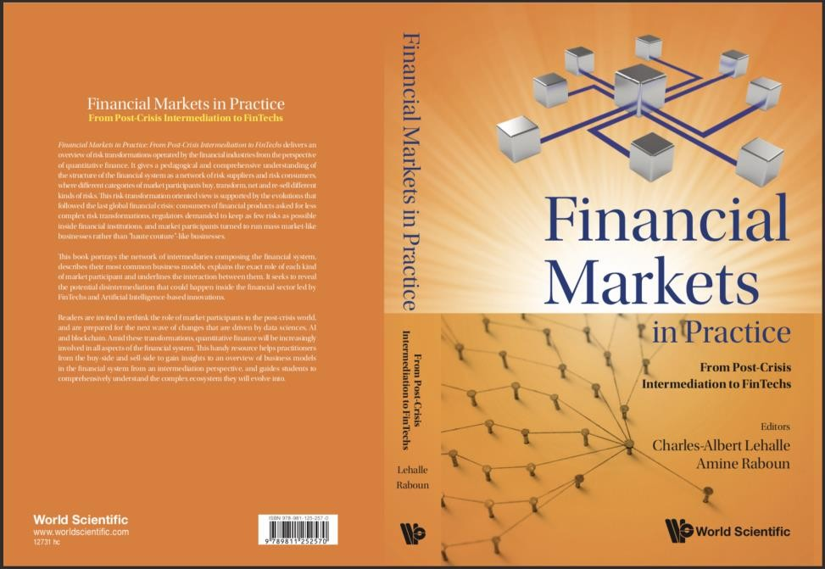
To go further
To go further:
Financial Markets in Practice: From Post Crisis Intermediation to FinTechs
by Charles-Albert Lehalle
and Amine Raboun
(World Scientific Publisher, June 2022)

Slide 44
References
Alekh Agarwal, Peter L. Bartlett, and Max Dama, Optimal Allocation Strategies for the Dark Pool Problem, Proceedings of The Thirteenth International Conference on Artificial Intelligence and Statistics (AISTATS) (Y. W. Teh and M. Titterington, eds.), vol. 9, May 2O1O, pp. 9–16.
Yakov Amihud, Haim Mendelson, and Lasse H. Pedersen, Liquidity and Asset Prices, Social Science Research Network Working Paper Series (2O1O).
Robert Almgren, Chee Thum, Emmanuel Hauptmann, and Hong Li, Direct Estimation of Equity Market Impact, Risk Ł8 (2OO5), 57–62.
Antoine Bouveret, Cyrille Guillaumie, Carlos A. Roqueiro, Christian Winkler, and Steffen Nauhaus,
High-frequency trading activity in EU equity markets, Tech. report, ESMA, 2O14.
Nataliya Bershova and Dmitry Rakhlin, The Non-Linear Market Impact of Large Trades: Evidence from Buy-Side Order Flow, Tech. report, December 2O12.
Olivier Guéant, Charles-Albert Lehalle, and Joaquin Fernandez-Tapia, Dealing with the inventory risk: a solution to the market making problem, Mathematics and Financial Economics 4 (2O13), no. 7, 477–5O7.
C.-A. Lehalle, ADIA

Slide 45
References
Kuzman Ganchev, Yuriy Nevmyvaka, Michael Kearns, and Jennifer W. Vaughan, Censored exploration and the dark pool problem, Commun. ACM 53 (2O1O), no. 5, 99–1O7.
Sanford J. Grossman and Joseph E. Stiglitz, On the Impossibility of Informationally Efficient Markets, The American Economic Review 70 (198O), no. 3, 393–4O8.
Tsy Ho and H. R. Stoll, The dynamics of dealer markets under competition, Journal of Finance 38
(1983), no. 4, 1O53–1O74.
Albert P. Kyle and Anna A. Obizhaeva, Large Bets and Stock Market Crashes, Tech. report, Market Microstructure: Confronting Many Viewpoints, July 2O13.
Charles-Albert Lehalle, Market Microstructure knowledge needed to control an intra-day trading process, Handbook on Systemic Risk (Jean-Pierre Fouque and Joseph Langsam, eds.), Cambridge University Press, May 2O13.
Charles-Albert Lehalle, Olivier Guéant, and Julien Razafinimanana, High Frequency Simulations of an Order Book: a Two-Scales Approach, Econophysics of Order-Driven Markets (F. Abergel,
B. K. Chakrabarti, A. Chakraborti, and M. Mitra, eds.), New Economic Windows, Springer, 2O1O.
C.-A. Lehalle, ADIA

Slide 46
References
Charles-Albert Lehalle, Sophie Laruelle, Romain Burgot, Stéphanie Pelin, and Matthieu Lasnier,
Market Microstructure in Practice, World Scientific publishing, 2O13.
Aimé Lachapelle, Jean-Michel Lasry, Charles-Albert Lehalle, and Pierre-Louis Lions, Efficiency of the Price Formation Process in Presence of High Frequency Participants: a Mean Field Game analysis, May 2O13.
Sophie Laruelle, Charles-Albert Lehalle, and Gilles Pagès, Optimal posting price of limit orders: learning by trading, Mathematics and Financial Economics 7 (2O13), no. 3, 359–4O3.
Francis A. Longstaff, How Much Can Marketability Affect Security Values?, The Journal of Finance
50 (1995), no. 5, 1767–1774.
Robert C. Merton, A Functional Perspective of Financial Intermediation, Financial Management
24 (1995), no. 2, 23+.
Esteban Moro, Javier Vicente, Luis G. Moyano, Austin Gerig, Doyne J. Farmer, Gabriella Vaglica, Fabrizio Lillo, and Rosario N. Mantegna, Market impact and trading profile of large trading orders in stock markets, August 2OO9.
C.-A. Lehalle, ADIA

Slide 47

References
Gilles Pagès, Sophie Laruelle, and Charles-Albert Lehalle, Optimal split of orders across liquidity pools: a stochastic algorithm approach, SIAM Journal on Financial Mathematics 2 (2O11), 1O42–1O76.
C.-A. Lehalle, ADIA

